Slide 1



FINAL PRESENTATION
GROUP 14

Slide 2
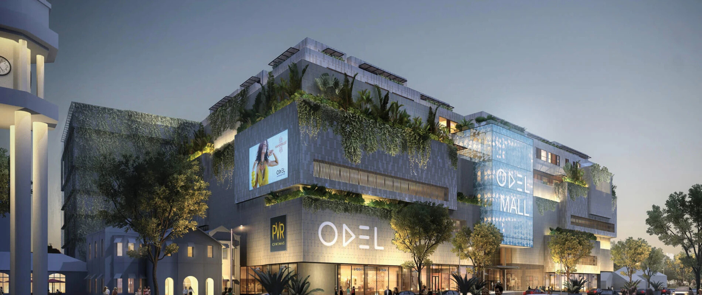
Project Title
Investigating financial losses incurred by ODEL PLC
Purpose of the project
To offer various strategies to aid ODEL in becoming profitable again

Slide 3





PROBLEM STATEMENT
Problem Description
Significance
Background
Subsidiary companies like Odel have been experiencing consistent losses, raising concerns about their long-term sustainability under Softlogic Holdings PLC.
It provides actionable strategies to address the root causes of financial losses, aiding in the company's turnaround which would help the stakeholders make informed decisions by analyzing data-driven insights.
Odel reported a loss of 1.7 billion LKR in 2023, a notable increase from 1.2 billion LKR compared to the previous year. This ongoing financial decline raises critical concerns about the ability of such subsidiaries to remain viable in the future.

Slide 4
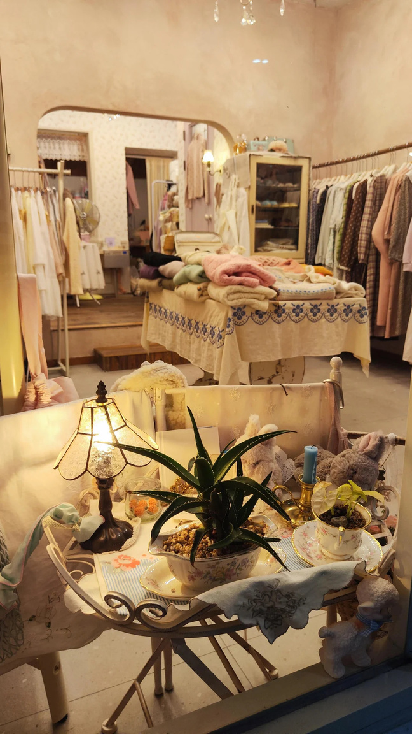


GAP ANALYSIS
Existing Solutions
The company is taking steps to improve its performance by ;
Closing down stores ( Battaramulla, Majestic City, and Colombo City Centre stores have been closed)
Restructuring debt repayments with lenders
Raising money with rights issues (Rs.10 Billion)
Limitations
There's not enough detailed research on how Sri Lankan customers shop, their lifestyles, or how they view brands.
There's also a lack of information about how Odel's competitors in Sri Lanka impact its revenue.
Very little is known about how Odel manages logistics, operational costs, and decision-making, which might be causing losses.

Slide 5


The outlets closed
ODEL BATTARAMULLA
ODEL MAJESTIC CITY
ODEL LIBERTY PLAZA
ODEL
KOLLUPITIYA

Slide 6

OBJECTIVES AND RESEARCH QUESTIONS
Main objective
To find possible solutions for Odel PLC to earn profit again
Specific objectives
Do particular expenses affect the profit Odel is incurring?
To find the relationship between the sales Odel achieves every year and why they make a loss even so.
To identify the challenges, they are facing with expenses
Research questions
Why have some outlets gone out of business?
Is the amount of sales the main reason for the losses?

Slide 7
METHODOLOGY
Data collection
The data was gathered by referring to the Odel PLC annual reports.
Data preprocessing
The dataset we used was not an existing dataset, the variables and values were derived from the annual report and were transformed into a dataset.
Techniques and tools
Excel, RStudio, Power BI, Google Colab

Slide 8
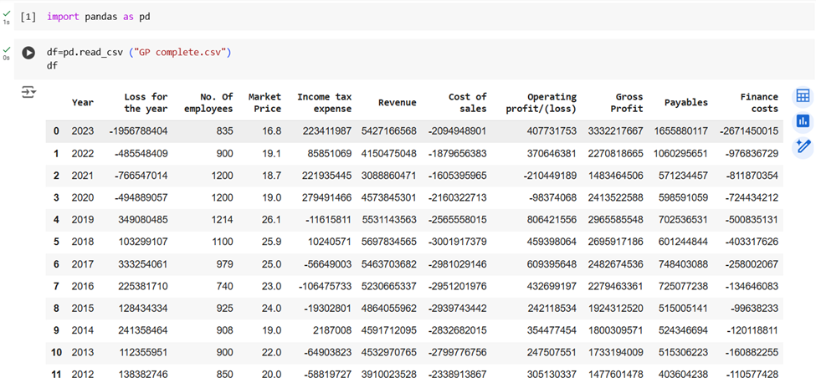
METHODOLOGY

Slide 9
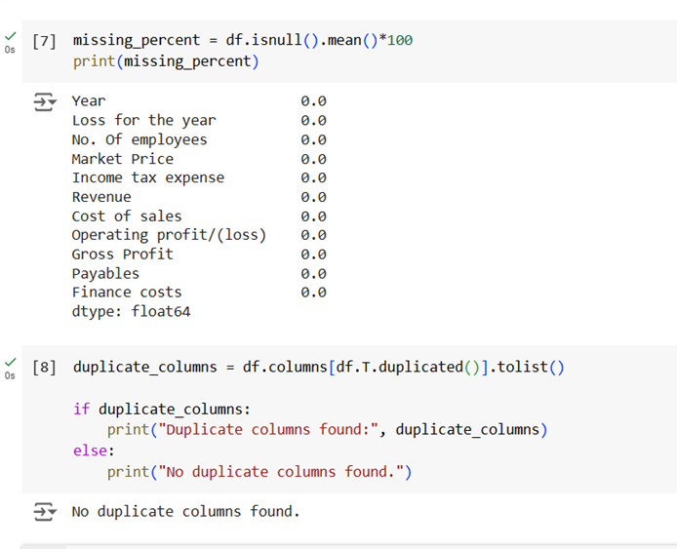
METHODOLOGY

Slide 10
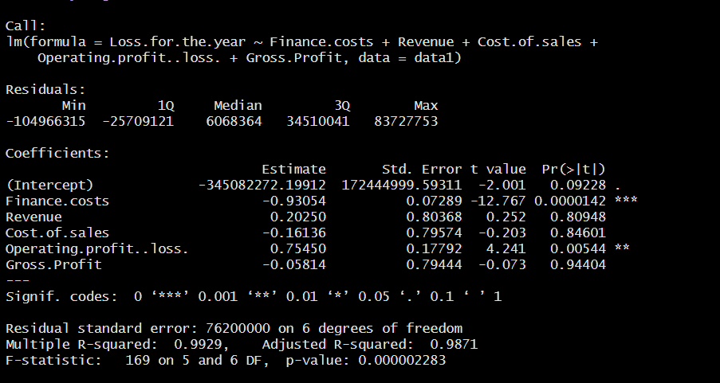
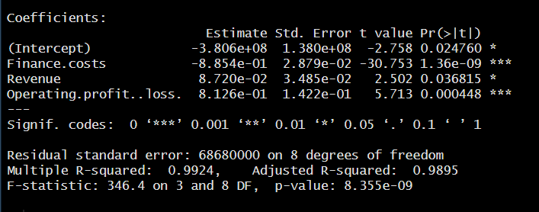
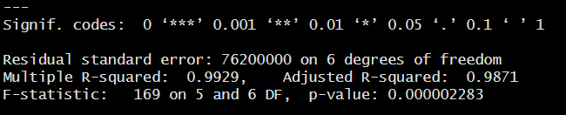
MULTIPLE LINEAR REGRESSION MODEL

Slide 11
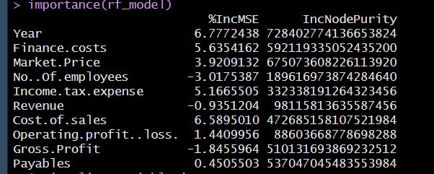
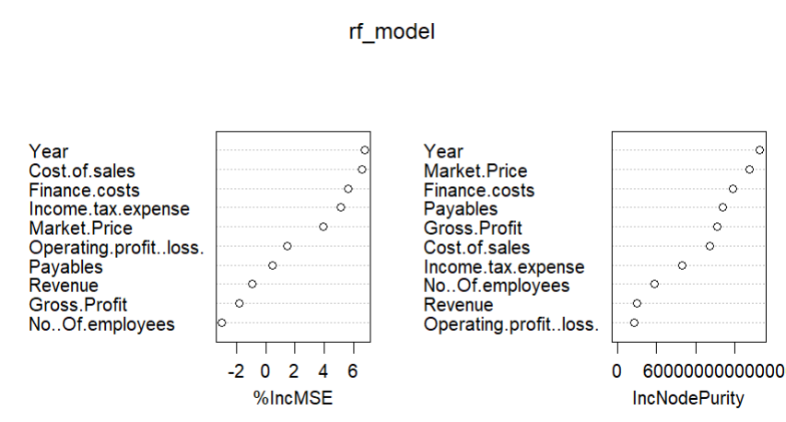
RANDOM FOREST MODEL

Slide 12
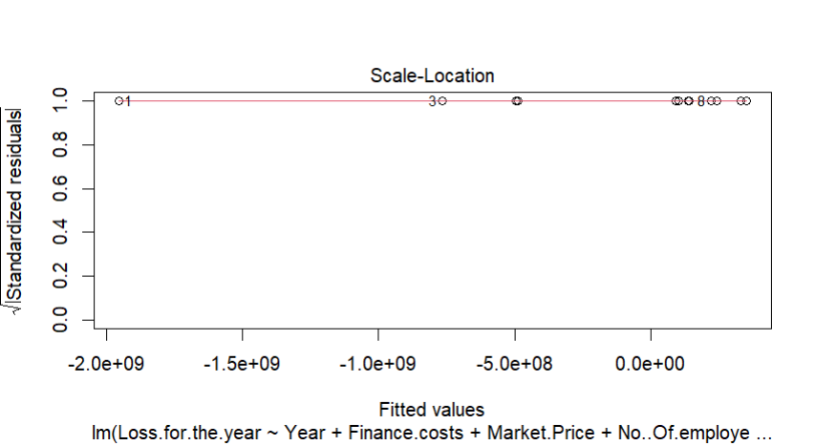
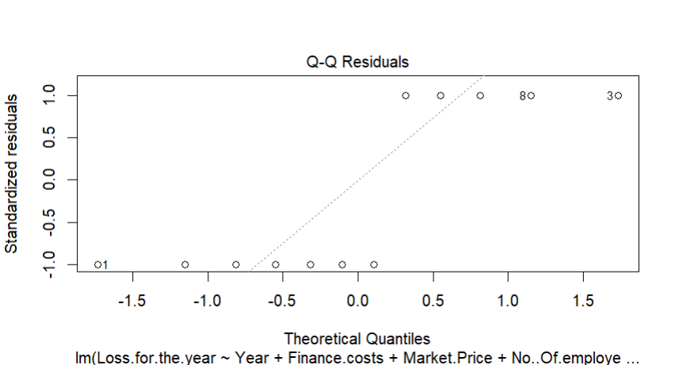

RESIDUALS

Slide 13
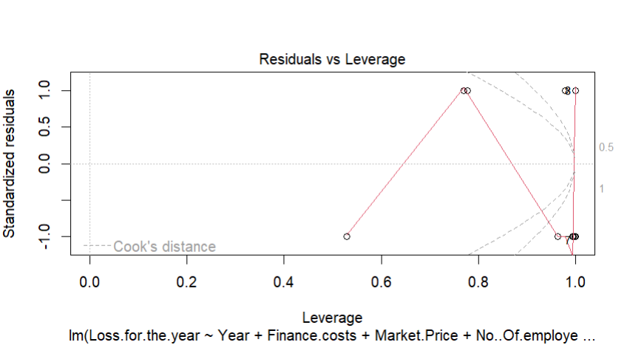
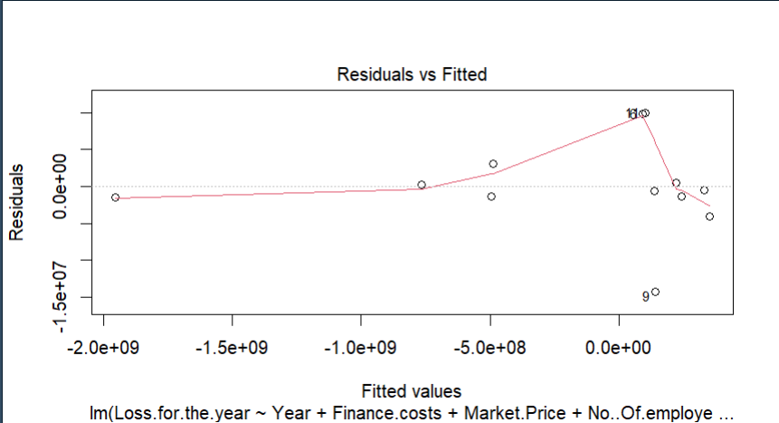

Slide 14

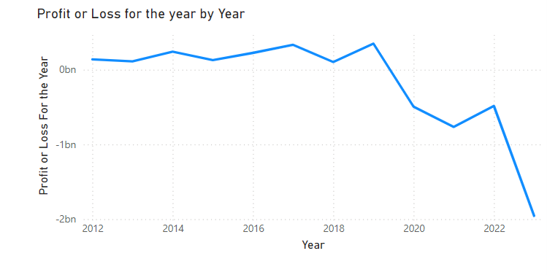
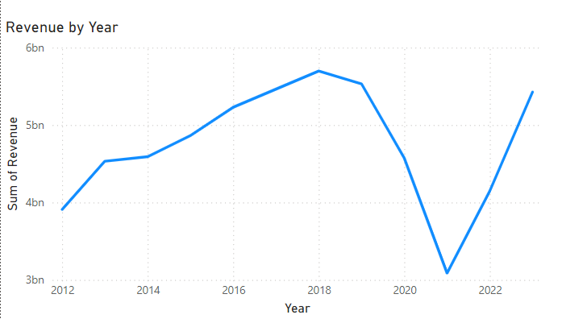
ANALYSIS AND FINDINGS

Slide 15
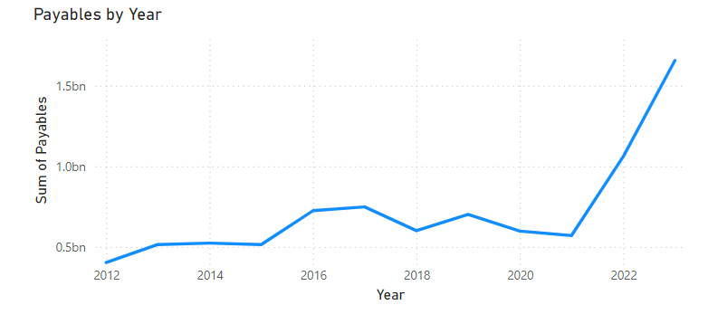
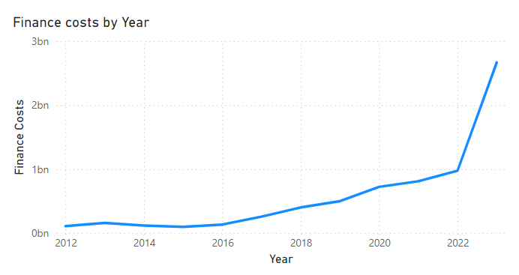

Slide 16
INSIGHT
THE PROFIT STARTED TO FLUCTUATE FROM THE YEAR 2019
THE REVENUE IS NOT A DIRECT CAUSE FOR THE LOSSES
THE CREDIT PAYABLES STARTED TO RAISE WITH THE LOSS
THE FINANCE COSTS ALSO INCREASED WITH THE LOSS

Slide 17

CHALLENGES AND LIMITATIONS
LIMITED CONSUMER INSIGHTS
THE LACK OF COMPREHENSIVE RESEARCH ON SRI LANKAN CUSTOMER BEHAVIOR MIGHT HINDER PRECISE TARGETING AND MARKETING
FINANCIAL CONSTRAINTS
THE ONGOING FINANCIAL LOSSES OF 1.7 BILLION LKR (AS OF 2023) RESTRICT THE AVAILABILITY OF FUNDS FOR RESEARCH, TECHNOLOGY UPGRADES, AND STRATEGIC EXPANSION
DEBTS
HIGH DEBT LEVELS AND REPAYMENT OBLIGATIONS COULD OVERSHADOW EFFORTS TO IMPROVE OPERATIONAL EFFICIENCY AND EXPAND THE BUSINESS

Slide 18

RECOMMENDATIONS
Optimize Outlet Network Focus on high-performing outlets and assess the need for underperforming ones. Convert underused spaces into discount stores, as done with Nugegoda, and expand into profitable locations like Havelock City Mall
Invest in Market Research
Conduct detailed studies on customer buying behavior, preferences, and competitor strategies to tailor offerings and promotions better
Digital Transformation Even though they have an online platform, it needs to be improved such as frequent posts and updates on the latest trends

Slide 19


IMPACT AND FUTURE WORK
·INCREASED PROFITABILITY THROUGH STREAMLINED OPERATIONS AND TARGETED MARKETING.
·Strengthened brand positioning by understanding consumer needs and preferences.
·Enhanced stakeholder confidence through visible improvements in performance metrics.
IMPACT
·CONDUCTING A DEEPER DIVE INTO CUSTOMER ANALYTICS TO BETTER UNDERSTAND SPENDING PATTERNS AND PREFERENCES.
·Expanding into digital retail platforms and enhancing customer experience through online services.
FUTURE WORK

Slide 20
CONCLUSION
BY TACKLING OPERATIONAL INEFFICIENCIES, LEVERAGING CUSTOMER INSIGHTS, AND IMPROVING FINANCIAL MANAGEMENT, ODEL PLC CAN TURN LOSSES INTO GAINS. WITH TARGETED STRATEGIES AND ADAPTABILITY, THE COMPANY CAN SECURE ITS PLACE AS A LEADING RETAILER IN SRI LANKA.

Slide 21

THANK YOU

